Slide 1
SNHA Technology Subcommittee
Draft of the 2026/2027 projects
September 22nd , 2026

Slide 2
Preparing for the Board Presentation about the Tech Subcommittee
  Committee’s Mission, Scope, Membership & Term
  Review of the RACI slides to describe the stakeholders, roles against projects and make sure we agree
  Communication process
Cheryl’s update including her onsite visits from last Tuesday and her project work over the next year
26/27 Project List
Comments from Homeowners Against Our 26/27 Project List
Next Meeting – Tuesday October 20, 2026 at 12 noon

Slide 3
About the SNHA Technology Committee for 2026/2027 Term and list of projects
About a RACI – RACI Definitions, Key Project Roles Defined, Best Practices for Implementations,
Comments from Homeowners against our 26/27 project list
Smuggs Technology Projects Starting with Sensors and Predictive Maintenance
Sample Sheet for Each of the Projects (for project discipline and management and monthly updates etc.)

Slide 4
SNHA Technology Committee 2026/2027 term
Mission:
The SNHA Technology Committee will be working to advance the technology needs of the SNHA and work in partnership with the Smugglers Notch Resort on technology projects for better outcomes for the homeowners and the resort. The work for the 26/27 term will include the sensor project, WiFi performance/adjustments, consistency for the SNHA communication and processes, Energy Management next phases and next generation of entertainment at the resort.
Meeting Cadence:
Zoom meeting on the Third Tuesday of each month at 12 noon
Membership:
Chair: Debbie Cicerone RS45 Committee members: Michele Cloke LS11 12, Jeremy Feldman MV27, Cheryl Gandini Smuggs IT Director, Joe Lamacchia HK20, Roml Lefkowitz HK04, Herb Lewis RS48, Rob Nagler LS53, Jorge Onieva MV10, Ron Packard MV09, Florrie Paige-HK13, Matt Spataro MV17, Lucas Tilton Smuggs
Scope - List of the 2026/2027 projects:
    Project 1) Sensors and Predictive Maintenance
    Project 2) Wi Fi Performance/Adjustments
Project 3) Consistency of the SNHA Communication and processes i.e. email addresses using snha.online & maximize usage of App Folio
Project 4) What’s Next after this phase and how do we get to full EMS
Project 5) Next Gen of Entertainment

Slide 5
RACI for the SNHA Technology Committee 2026/2027 term 1 / 2
Reason for a RACI:
To execute the project list for the 26/27 term e.g. Sensors & Predictive Maintenance (including environmental monitors, leak detectors, or smart thermostats) it is critical to align the decision-making process between individual Building Regimes, the centralized SNHA Board, and resort operations.
RACI Definitions:
R – Responsible: The role doing the actual work to complete the task.
A – Accountable: The final decision-maker with ultimate ownership of the outcome. (Only one "A" per task).
C – Consulted: People whose input is needed before or during the task.
I – Informed: People updated after the task or decision is finalized.
Key Project Roles Defined:
SNHA Board / Directors: The governing body focused on overarching community policies, legal reviews, and vendor guidelines.
Regime Directors (Building Committees): Individual building associations responsible for building-specific approvals, aesthetics, and localized funding.
SNHA Management / Office Staff: The operational team handling day-to-day coordination, project schedules, and contractor tracking.
Resort Management Co. (Smuggs Resort Tech/Maintenance): The main resort entity providing technical integration or baseline infrastructure utilities.
Homeowners (Full/Club Owners): Individual condo unit owners impacted by intra-unit hardware placement and user experience.
Third-Party Vendor / Contractor: Certified network technicians and IoT smart hardware installers.

Slide 6
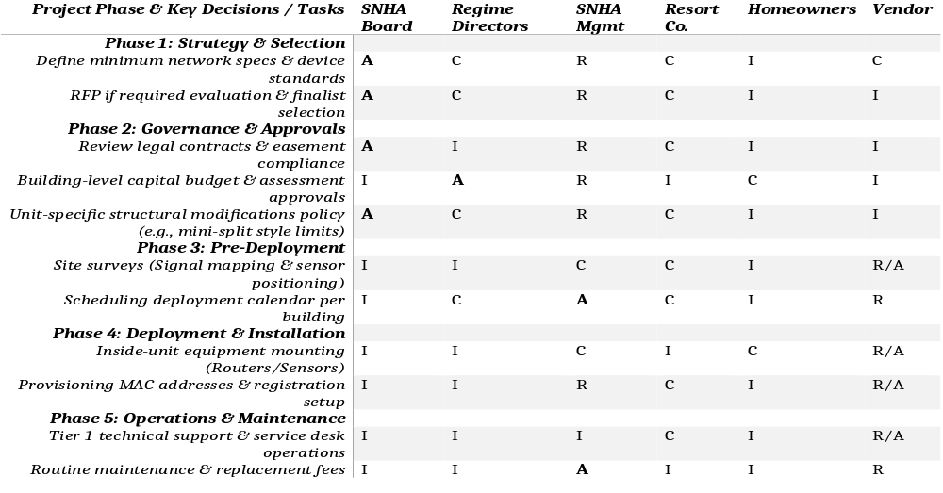
RACI for the SNHA Technology Committee 2026/2027 term 2/2
Best Practices for Implementation this RACI for the SNHA Technology Subcommittee Sensor Project:
1) Enforce the "Regime Split": Because Smuggs operates via separate building Regimes, central SNHA cannot unilaterally force structural modifications or individual capital expenditure spending on a specific building without that specific Regime’s Board approval. This is why Regime Directors hold the Accountable (A) status for localized funding and drilling/aesthetic approvals.
2) Harmonize with the Resort Network: Ensure that the Wi-Fi collaborates with the broader resort system (mconnect / SmuggsWifi) to avoid signal congestion or interference between resort public spaces and private residential spaces.
3) Owner Access Transparency: Because property usage spans personal utilization, Club programs, and third-party rentals, sensor data permissions (such as water leak warnings) must route automatically to SNHA Management or emergency maintenance for prompt mitigation, rather than uniquely alerting an off-site owner.

Slide 7
Comments from Homeowners Against Our 26/27 Project List
From Jay Kahn: Technology, the wifi continues to be terrible along with the additional media networks; the cable signal is also poor, is there discussion for fully internet system to get rid of coax (assuming homes can get a minimally acceptable signal)
From Ken Blum TE4: inconsistent internet
From Matt Helm Sterling 10: An issue that continues to plague us is the Energy Management System.
Since its implementation, we have faced unresolved issues that are
potentially damaging to our HVAC system. - Matthew Helm
From Michele: regarding communication on the process to set up new TVs in the newsletter since a majority have to buy new TVs by June
From Roml: email requesting an API from Smuggs because he installed internet enabled thermostats and temperature sensors in his home and he would like to implement home automation rule
List of the 2026/2027 projects:
    Project 1) Sensors and Predictive Maintenance
    Project 2) Wi Fi Performance/Adjustments
Project 3) Consistency of the SNHA Communication and processes i.e. email addresses using snha.online & maximize usage of App Folio
Project 4) What’s Next after this phase and how do we get to full EMS
Project 5) Next Gen of Entertainment

Slide 8
Sensors and Predictive Maintenance
Background for the Sensors Program
This program outlines a phased installation and continuous maintenance plan for IoT temperature and moisture sensors across Smugglers Notch. This program will mitigate pipe freezing risks in the winters and humidity/mold issues during unoccupied periods, centralizing data for the SNHA management team. The installation phases will include:
Phase 1: Pilot Program – equip a few diverse unit types and compare notes
Phase 2: Using the results of the pilot program craft a strategic approach for the sensor program – what decisions have to made by whom to scale the pilot – construct the RACI for this program
Phase 3: Hardware & Placement Strategy
Phase 4: SNHA Approval & Communication according to RACI
Phase 5: Building by building rollout
Phase 6: Maintenance and Monitoring Protocol
Current Status for Sensors Program
During the meeting on August 18th get a status from Florrie, Roml, Joe etc. regarding the Pilots. We will also need to understand a proper RACI for this program and the phases.
Next Steps and Time-line including Go/No Go decisions
Discussion on what’s next moving on from phase 1

Slide 9
Smuggs Technology Projects Sample 1 Pager for Each of the Projects
Background About the Project
This section will describe the project, why we need it, the expected outcomes, the time-lines, who is involved a proper RACI, etc.
Monthly Status for the Project
We will use the monthly meeting to get a status of each of the projects. These status’ will be used for communication via the newsletter, email, etc
Next Steps and Time-line
This section will detail what is next for this project

